Slide 1

Aero-engine Propagation Knowledge Graph System
任懿涛 34520232201115

Slide 2
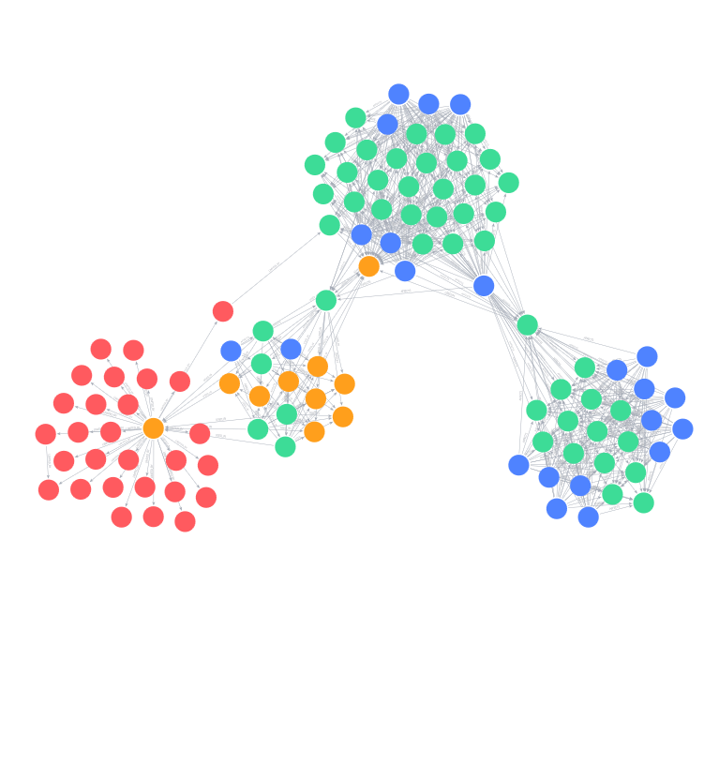

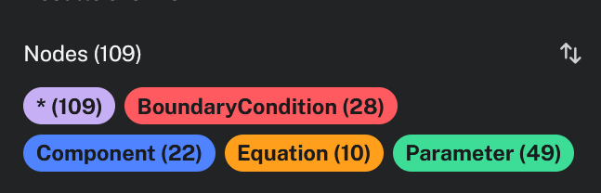
The Knowledge Silo Challenge
Aerospace physical modeling processes currently suffer from fragmented, document-isolated architectures:
Rigid Toolchains: Parameter data is locked in specialized 1D/3D design codes.
Untraceable Changes: Component changes downstream lack automated, structural impact pathway assessments.
Boundary Violations: Material thermal limit structures are decoupled from early-phase thermodynamical updates.
Objective: Reconstruct fragmented engineering dependencies into an actionable Engineering Knowledge Graph System enabling real-time topological propagation.
SLIDE 02
AERO-ENGINE KNOWLEDGE PROPAGATION

Slide 3
Five-Layer Ontology Design
We propose a rigorous five-layer engineering ontology designed to structuralize aerospace systems:
Subsystem Layer: Coarse boundaries (e.g., Compressor, Turbine).
Component Layer: Subsystem physical parts (e.g., Rotor, Blade).
Parameter Layer: High-fidelity quantified features (e.g., Temperature, Pressure).
Equation Layer: Rules connecting parameters through numeric logic.
BoundaryCondition: Defining safety/material tolerances and environmental bounds.
SLIDE 03
AERO-ENGINE KNOWLEDGE PROPAGATION

Slide 4
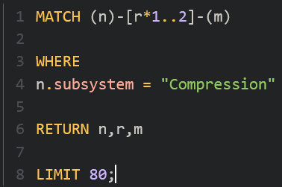
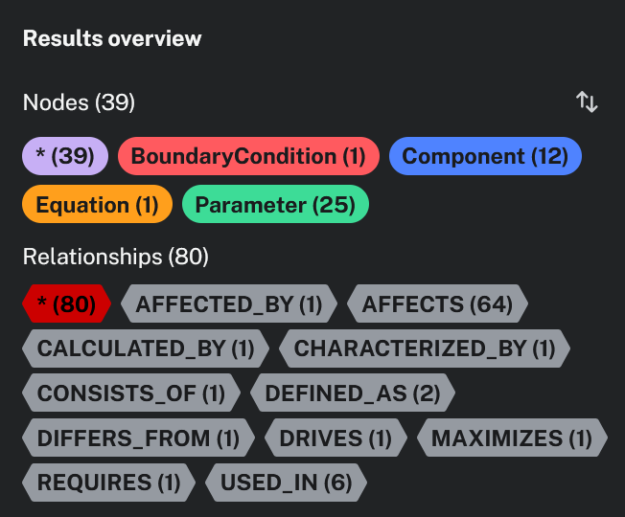
Compression Subsystem Model
SLIDE 04
AERO-ENGINE KNOWLEDGE PROPAGATION

Slide 5
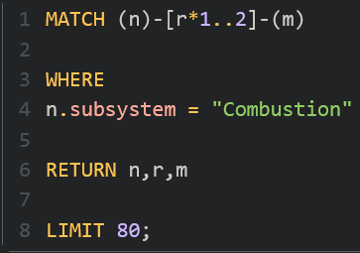
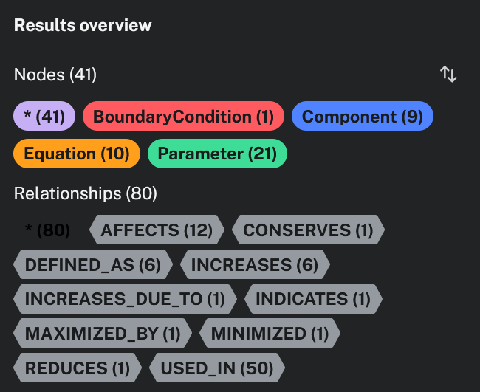
Combustion Subsystem Model
SLIDE 05
AERO-ENGINE KNOWLEDGE PROPAGATION

Slide 6
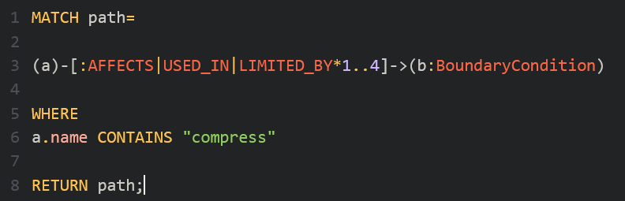
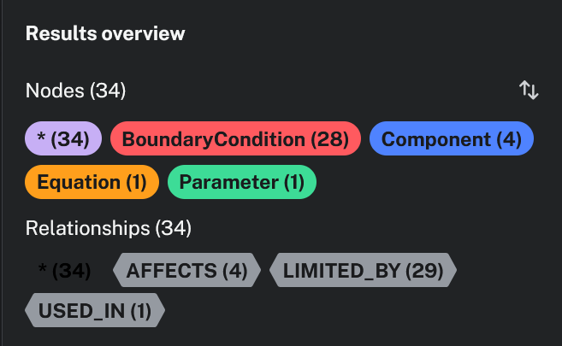

Multi-Domain Semantic Logic
GOVERNING THERMAL COUPLING
SLIDE 06
AERO-ENGINE KNOWLEDGE PROPAGATION

Slide 7
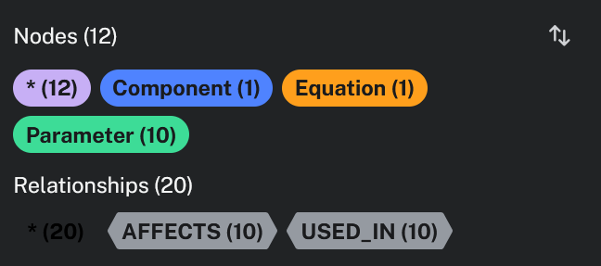
Path Propagation Traversal (compression as example)
SLIDE 07
AERO-ENGINE KNOWLEDGE PROPAGATION

Slide 8
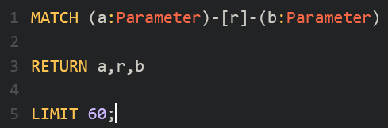
Parameter Coupling Hubs
SLIDE 09
AERO-ENGINE KNOWLEDGE PROPAGATION

Slide 9
Constraint Network Bounds
SLIDE 10
AERO-ENGINE KNOWLEDGE PROPAGATION

Slide 10



Interactive Offline System
本项目开源，github仓库地址：https://github.com/ren2335/engine-kg
Python ETL
Neo4j Aura
vis.js Engine
HTML Export
Constructs nodes and relationships directly from structured CSV topologies.
Ensures robust cloud graph hosting and complex Cypher query execution.
Compiles graphs into interactive, hardware-accelerated vectors.
Allows designers to search, filter, and inspect systems offline.
SLIDE 11
AERO-ENGINE KNOWLEDGE PROPAGATION

Slide 11



Thanks for listening
Engineering Graph
Traceability & Bounds
Offline Deployment
Breaking traditional paper silos to establish dynamic, cross-domain parameter dependencies.
Tracing propagation pathways and checking boundary limit states instantly.
Standalone HTML distribution with high performance node search and filtering features.

